Slide 2
Calculating App Trader’s Expected Profit
Apps earn $5,000 per month per store from in-app purchasing and advertising
App Trader’s revenue is 50% of that ($2,500 per month per store)
App Trader spends $1,000 per month on marketing costs (even when the app is in both stores)
Therefore, Net Revenue = (Lifespan in months) * $2,500 per store
App Trader purchases apps for 10,000 * the price of the app
Net Profit =
Net Revenue – (Lifespan in months * $1,000) – App Purchase Price

Slide 3
Net Profit and Costs: Top 10 Apps

Slide 4
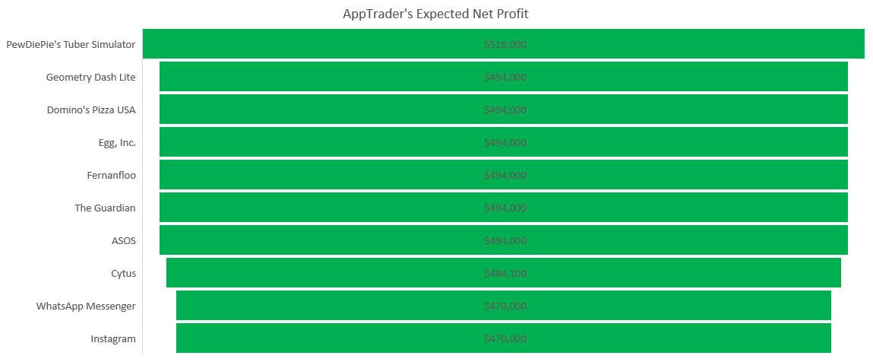
Expected Net Profit: Top 10 Apps

